Slide 1
Harnessing Customer Sentiment: Insights from Foursquare for Business Improvement

Slide 2
Understanding Your Customers through Sentiment Analysis
Brief overview of why customer feedback matters
Customer opinions are crucial for success and growth.
They provide direct insights into customer satisfaction and dissatisfaction.
Value of online reviews: they influence reputation, business decisions, and customer retention
Online reviews are a primary source of information for potential customers.
They directly impact your businesses’s online reputation and attract new patrons.
Introduce the solution: an automated tool that collects and analyzes Foursquare reviews
We offer an innovative tool designed to automate the process of understanding customer feedback.

Slide 3
How It Works Behind the Scenes
Fetches customer reviews from Foursquare based on business name & location
Our application intelligently retrieves publicly available reviews from Foursquare.
Analyzes sentiment using AI (VADER Sentiment Intensity Analyzer)
It processes each review using advanced AI to determine its emotional tone (positive, negative, neutral).
Detects keywords related to service, food, ambiance, price, cleanliness
The system identifies key terms customers use when discussing specific aspects of their experience.

Slide 4
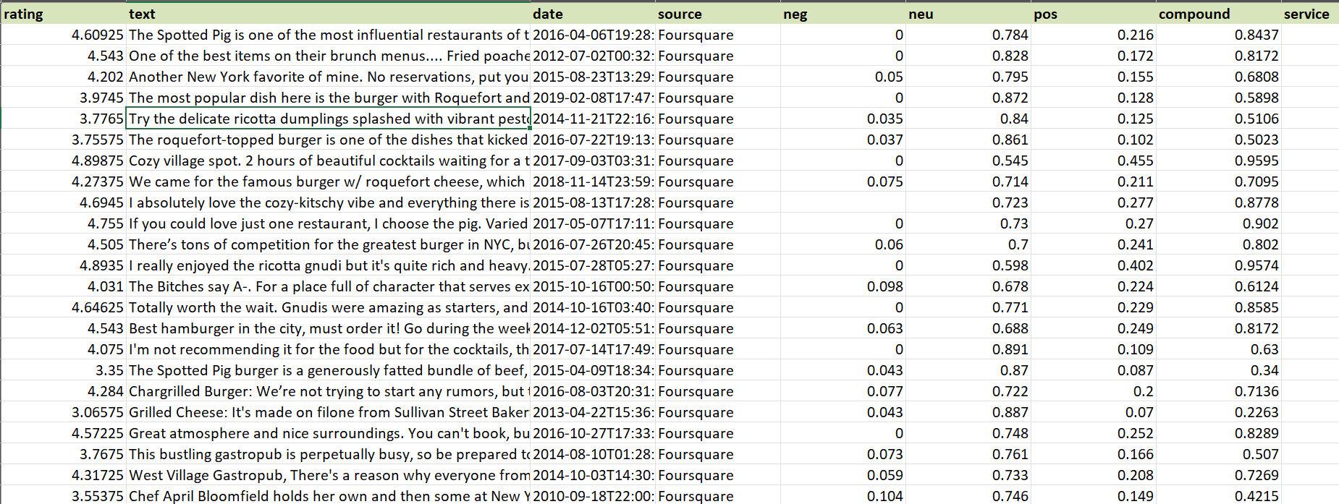
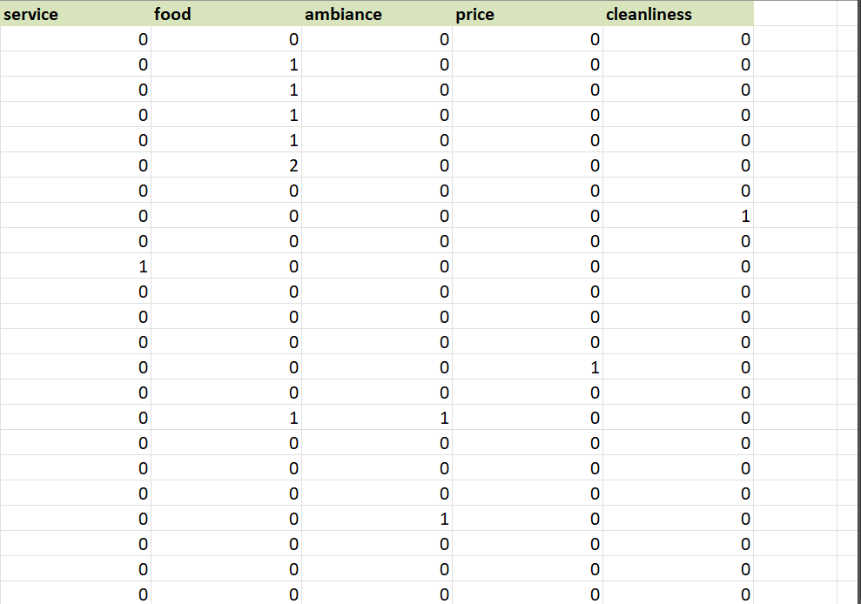
Output Sample

Slide 5
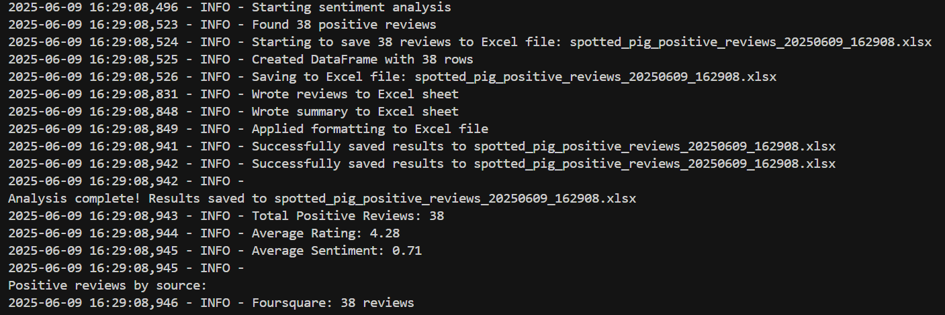
Output Sample(Logs)

Slide 6
Business Benefits
Understand what customers love — double down on strengths
Pinpoint specific areas where your business excels, allowing you to enhance these strengths.
Detect patterns in what they dislike
Identify recurring issues that might be impacting customer satisfaction.
Improve service, cleanliness, menu, or pricing based on data
Make data-driven decisions to address weaknesses and optimize operations.
Use positive reviews in marketing campaigns
Leverage glowing testimonials to attract new customers and build your brand.

Slide 7
Focusing on Areas of Improvement
Currently:
Filters and saves only positive reviews (compound ≥ 0.2)
With a small change modify the filter to target negative reviews:
negative_reviews = [review for review in analyzed_reviews if review['compound'] <= -0.2]
Adjust summary to include:
Top negative keywords (e.g., “dirty”, “slow service”)
Frequent complaint categories
Timeline to spot recent dips in sentiment (helps track trends and act quickly)

Slide 8
Custom Modifications for Your Business
We can tailor the application to:
Send weekly reports of negative reviews directly to your inbox.
Trigger alerts if sentiment drops sharply, allowing for immediate action.
Integrate multiple review platforms (e.g., Google, Yelp) for a holistic view.

Slide 9
Handling Data Securely
Only public data is used (from Foursquare)
We strictly adhere to privacy policies by only accessing publicly available information.
API keys are stored securely (.env file)
All sensitive credentials are protected using industry-standard security practices.
No customer data is modified or republished
Your customer's original reviews remain untouched and are not redistributed.

Slide 10
THANK YOU!

